Slide 1
Advanced DNA & Technology
Chapter
20

Slide 2
Genetic Engineering
Restriction enzymes (or restriction endonucleases)
  cut DNA at specific sites (restriction sites)
  ex: EcoRI
Sticky ends
  staggered cuts on restriction fragments as a result of restriction enzymes
  DNA ligase seals sticky ends
Recombinant DNA
  foreign DNA combined with an organism’s DNA

Slide 3
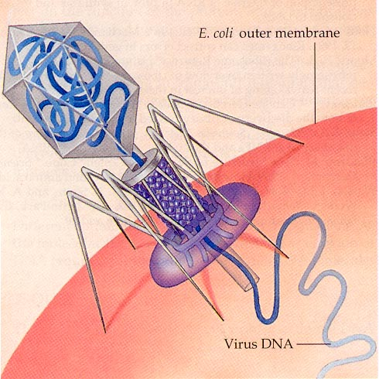
DNA Restriction Enzymes
• Evolved by bacteria to protect against viral DNA infection
• Endonucleases = cleave within DNA strands
• Over 3,000 known enzymes

Slide 4
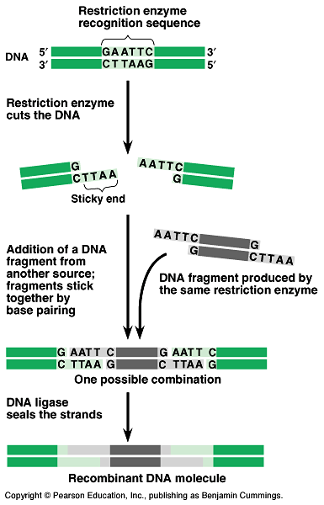

Slide 5


Enzyme Site Recognition
Restriction site
Palindrone
• Each enzyme digests (cuts) DNA at a specific sequence = restriction site
• Enzymes recognize 4- or 6- base pair, palindromic sequences
(eg GAATTC)
Fragment 1
Fragment 2

Slide 6
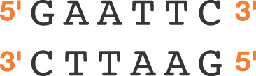

5 vs 3 Prime Overhang
Enzyme cuts
• Generates 5 prime overhang

Slide 7
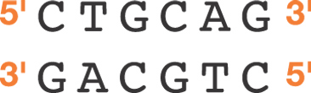
Common Restriction Enzymes
EcoRI
– Eschericha coli
– 5 prime overhang
Pstl
– Providencia stuartii
– 3 prime overhang

Slide 8
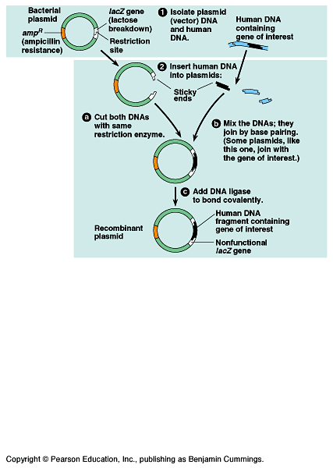
GENE CLONING

Slide 9
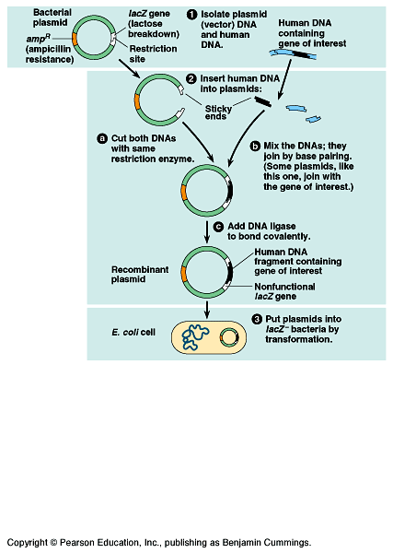
GENE CLONING

Slide 10
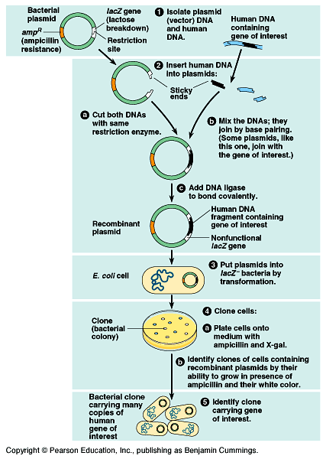
GENE or “DNA” CLONING

Slide 11
DNA Cloning
Usually involves bacterial cells because of special circular DNA they posses, called plasmids
Scientists insert the gene from human (desired gene) and mix with bacterial plasmids.
With new gene, bacteria cells can now produce substance that gene can make.
Allow bacteria to reproduce many times (they reproduce asexually = cloning)

Slide 12
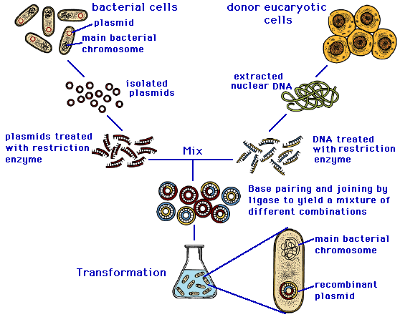
DNA Cloning

Slide 13
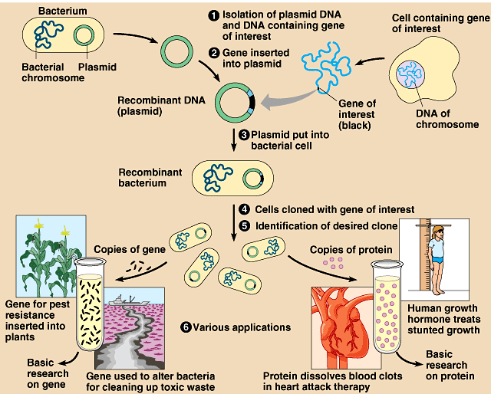

Slide 14
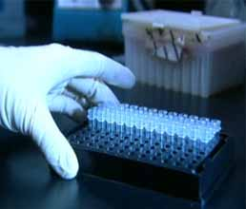
Polymerase Chain Reaction (PCR)
Cloning DNA rapidly without bacteria
Heat DNA sample to separate strands
When mixture cools, add primer
Add free nucleotides & DNA polymerase
Repeat process to rapidly increase DNA sample
Used to prepare large quantities in a short time

Slide 15
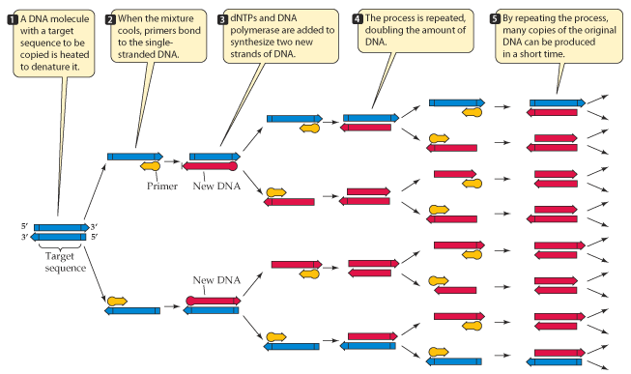
Polymerase Chain Reaction (PCR)

Slide 16
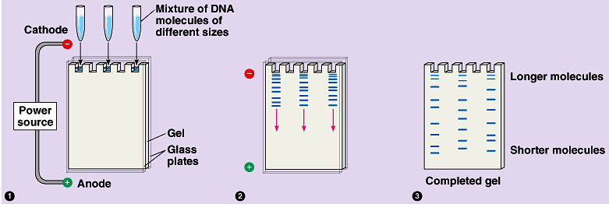
Gel Electrophoresis
Small DNA fragments or large DNA sample is cut with restriction enzymes
Gel electrophoresis separates fragments based on size and charge
Fragments move through the gel at different rates
Samples from the same original DNA will produce identical bands
Samples from different DNA will produce different banding patterns

Slide 17
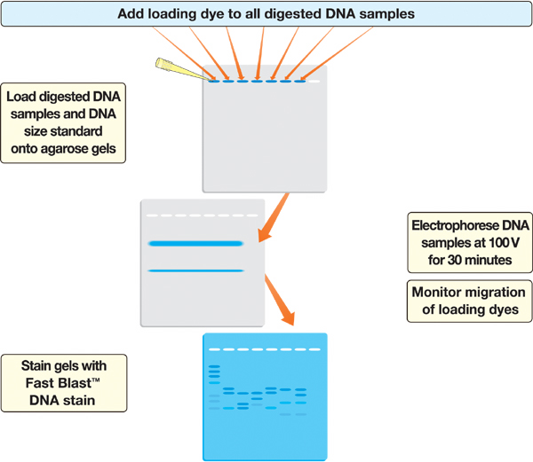
DNA
Fingerprinting

Slide 18
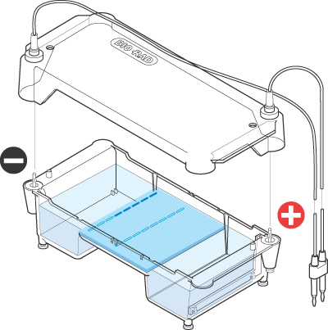

Agarose Electrophoresis Loading
• Electrical current carries negatively-charged DNA through gel towards positive (red) electrode
Buffer
Dyes
Agarose gel
Power Supply

Slide 19
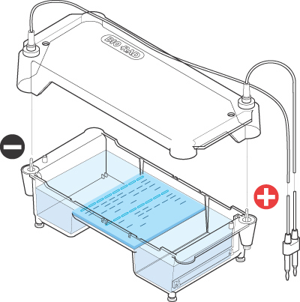
Agarose Electrophoresis Running
• Agarose gel sieves DNA fragments according to size
– Small fragments move farther than large fragments
Gel running
Power Supply

Slide 20
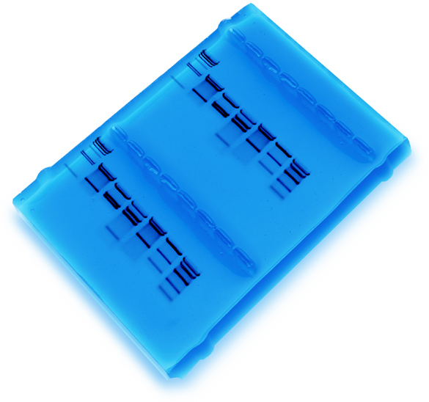
Analysis of Stained Gel
Determine
restriction fragment
sizes
• Create standard curve using DNA marker
• Measure distance traveled by restriction fragments
• Determine size of DNA fragments
Identify the related
samples

Slide 21
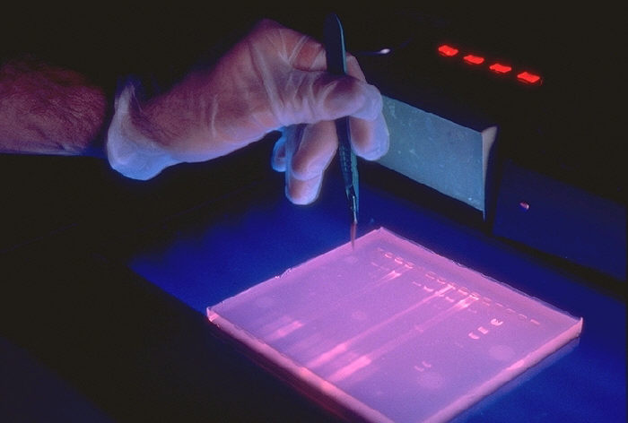

Slide 22
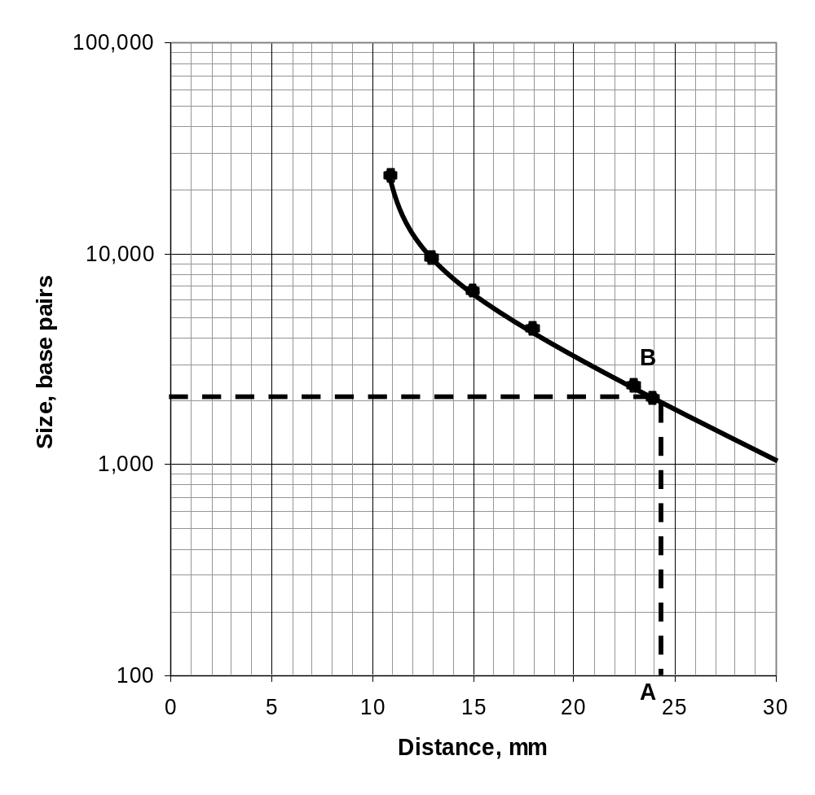
Molecular Weight Determination
Size (bp) Distance (mm)
23,000 11.0
9,400 13.0
6,500 15.0
4,400 18.0
2,300 23.0
2,000 24.0
Fingerprinting Standard Curve: Semi-log

Slide 23
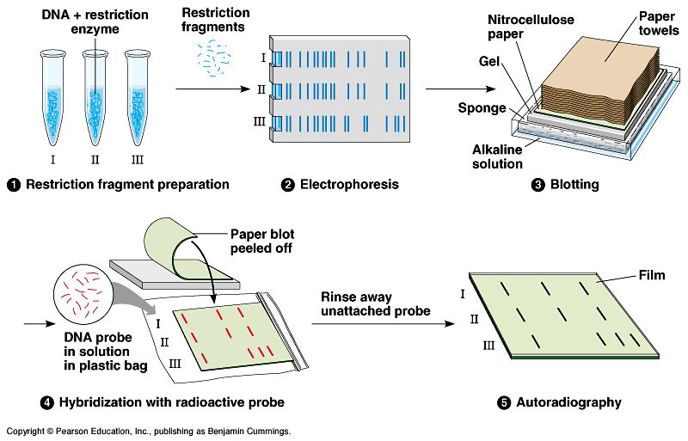
Southern Blotting – combination of gel electrophoresis and nucleic acid hybridization

Slide 24
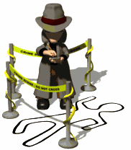
Crime Scene Investigators

Slide 25
Forensic DNA
RFLP (restriction fragment length polymorphism)
PCR analysis (polymerase chain reaction)
DNA Fingerprinting
  A unique array of DNA sequences that were inherited
STR analysis (short tandem repeats)
  Short DNA sequences present in many copies, one after one another – used as markers to differentiate between individuals (since different people have different numbers of repeats)

Slide 26
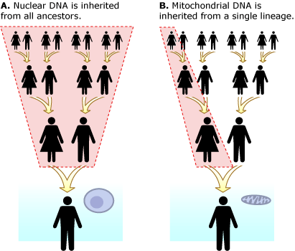
Forensic DNA (continued)
Unlike nuclear DNA, which is inherited from both parents and in which genes are rearranged in the process of recombination, there is usually no change in mtDNA from parent to offspring.
mtDNA is a powerful tool for tracking ancestry through females and has been used in this role to track the ancestry of many species back hundreds of generations.

Slide 27
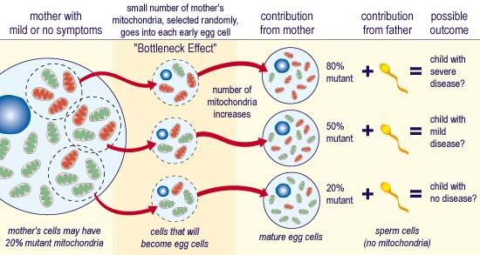
Mitochondrial DNA

Slide 28
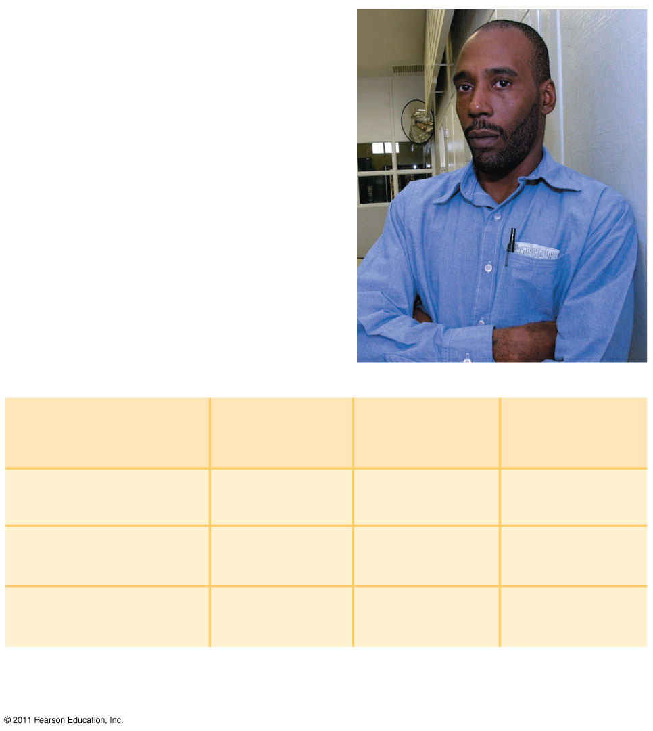
(a)
This photo shows
Washington just before
his release in 2001,
after 17 years in prison.
(b)
Source of
sample
STR
marker 1
STR
marker 2
STR
marker 3
Semen on victim
17,19
13,16
12,12
Earl Washington
16,18
14,15
11,12
Kenneth Tinsley
17,19
13,16
12,12
Notes:
Figure 20.25 STR analysis used to release an innocent man from prison.

Slide 29
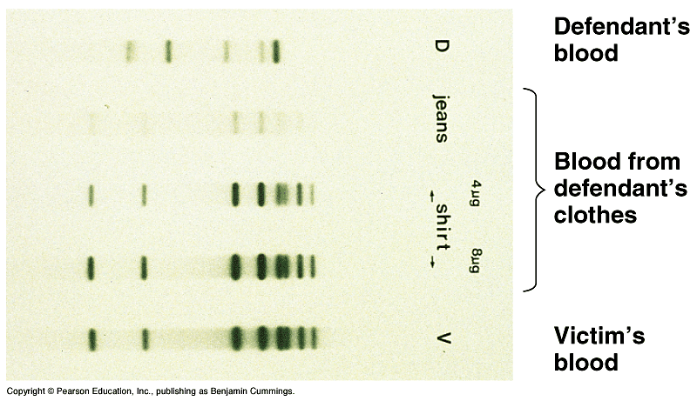
Gel used in forensics

Slide 30
Restriction Fragment Length Polymorphism
There are many regions of non-coding DNA in animal and plant genomes.
RFLPs are scattered abundantly throughout genomes and can help identify differences between individuals.

Slide 31
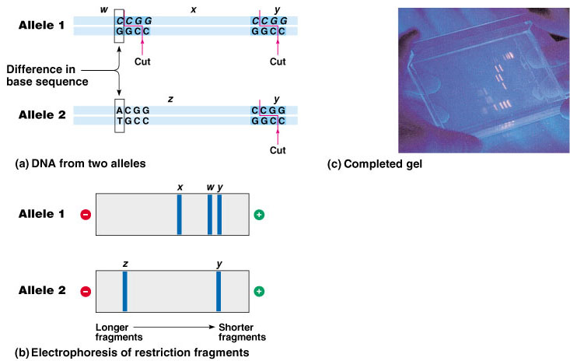
Restriction Fragment Length Polymorphism
“RFLP”

Slide 32
GM organisms
Transgenic organism/chimera
  an organism that contains recombinant DNA from another animal
  May be used to create animals with better wool (sheep), quicker growth rates, leaner meat, or larger muscles. Plants could be grown resistant to herbicides and pests or implanted with extra nutrients/vitamins.
Genetically modified (GM) foods
  An organism that has acquired by artificial means one or more genes from the same or another species.

Slide 33
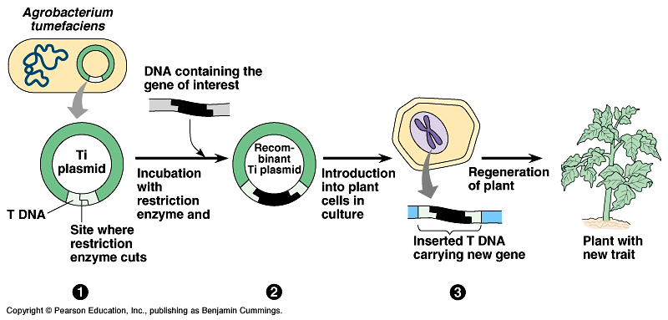

Slide 34
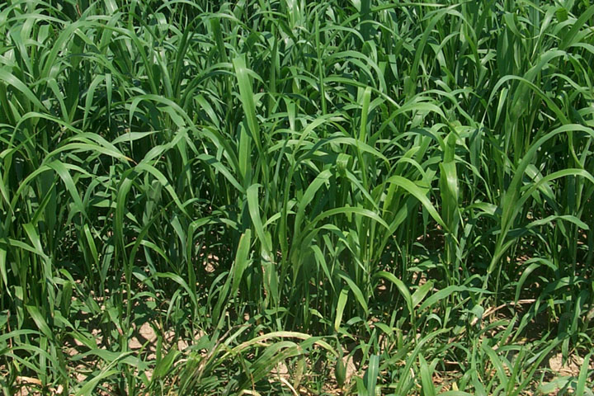


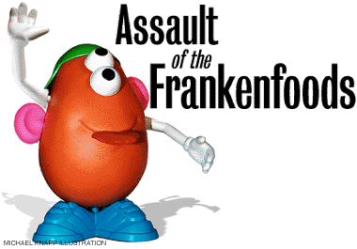

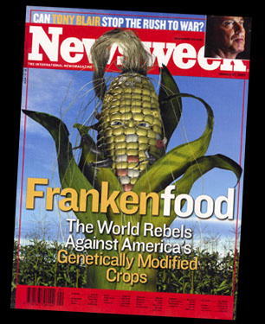
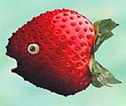

Genetically Modified Foods

Slide 35
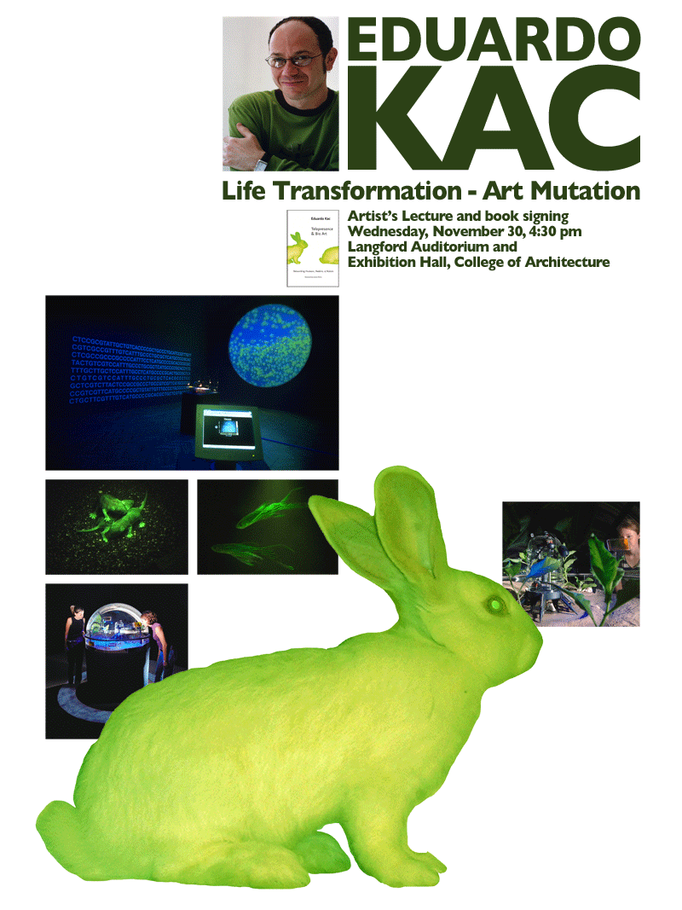

Slide 36
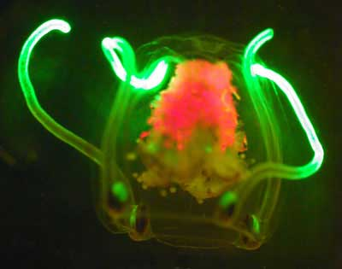
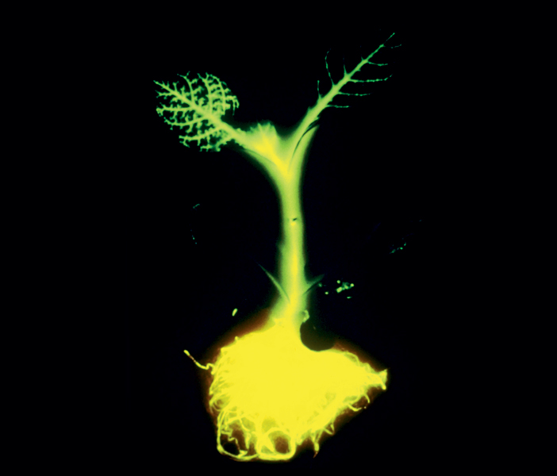
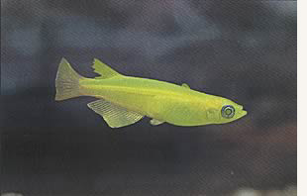
Recombinant organisms

Slide 37
Most public concern about possible hazards centers on genetically modified (GM) organisms used as food
Some are concerned about the creation of “super weeds” from the transfer of genes from GM crops to their wild relatives
Other worries include the possibility that transgenic protein products might cause allergic reactions
© 2011 Pearson Education, Inc.

Slide 38
Human Genome Project
Goal was to map complete genome of Homo sapiens (along the way they also mapped out the genome of a bacterium and the fruit fly)
Work began in 1990 and took about 10 years to complete most of the work with an additional 2 years to finally complete the work.
This process was completed using many machines and computers by two groups, a company named Celera (Venter) and by public funded group.

Slide 39
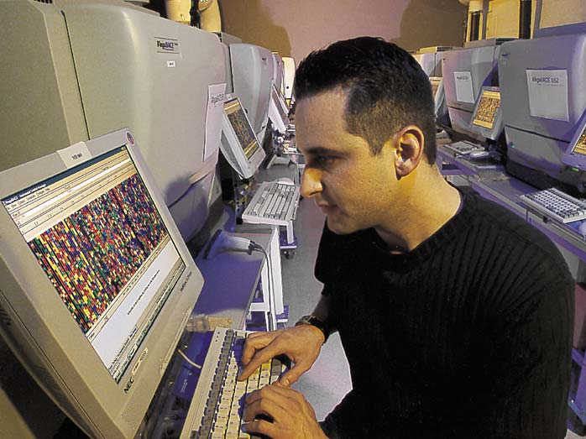
Mapping & sequencing of human DNA has been made possible by DNA technology

Slide 40
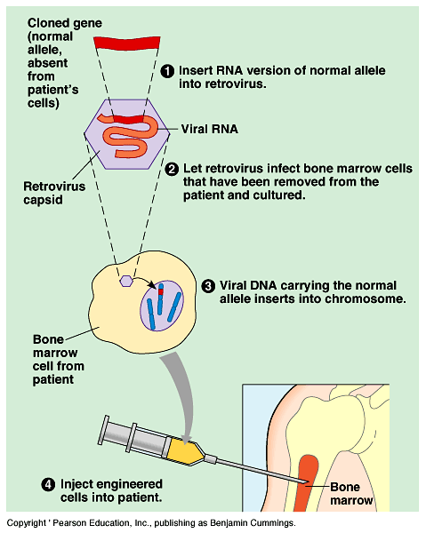
Gene Therapy
Gene therapy is the alternation of an afflicted individual’s genes
Using this technique, a normal allele of the defective gene could be inserted into the somatic cells of the tissue affected
Cells that receive the normal allele must multiply throughout the patient’s life (bone marrow stem cells)

